Slide 1
 | Age (yrs) | Gender | Education (yrs) | MoCA
Younger Adults (n=31) | 23.65 (2.86) | 54.80% female (n=17) | 15.90 (2.27) | N/A
Older Adults (n=27) | 73.44 (7.06) | 51.90% female (n=14) | 15.30 (3.69) | 28.11 (1.01)
Data from first 8 blocks used consistently across block and trial-level analyses.

Slide 2
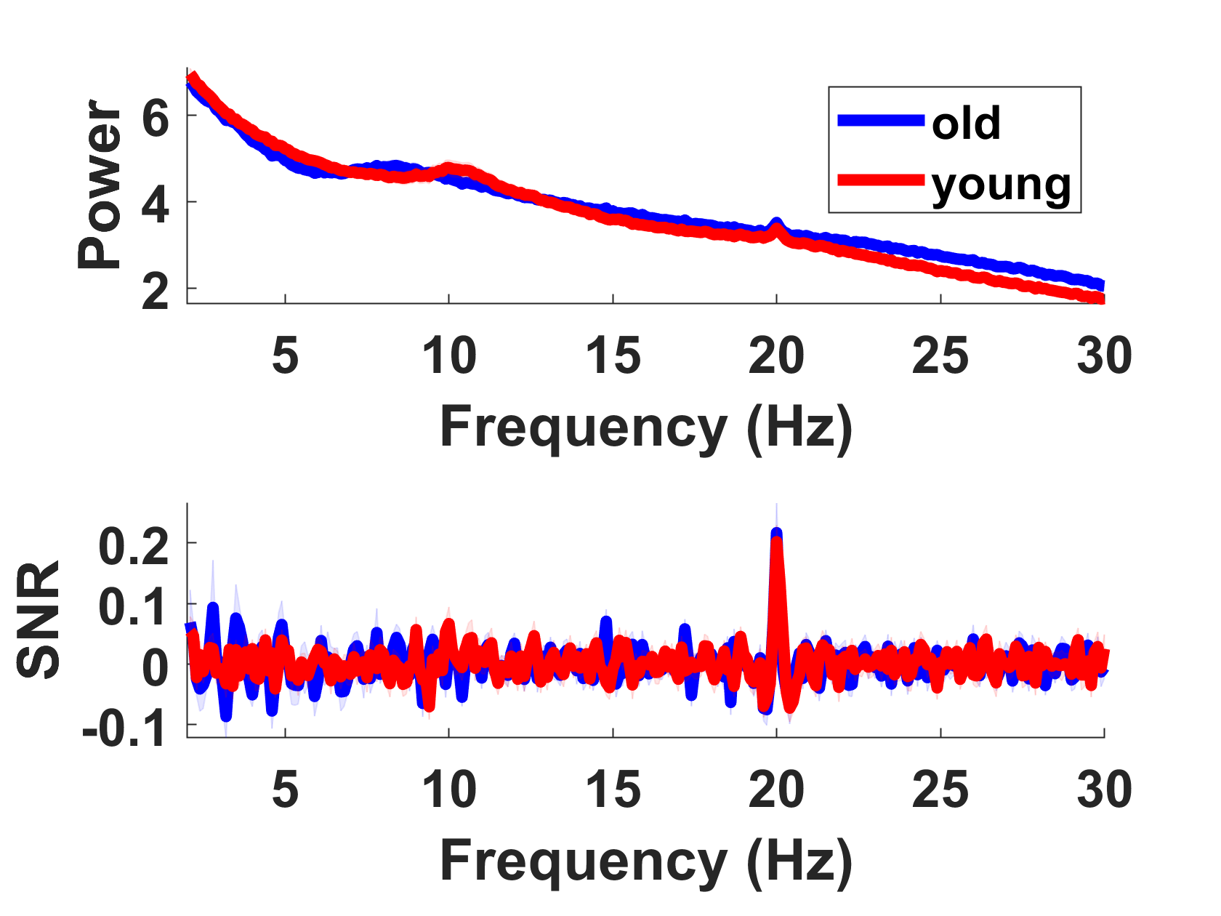
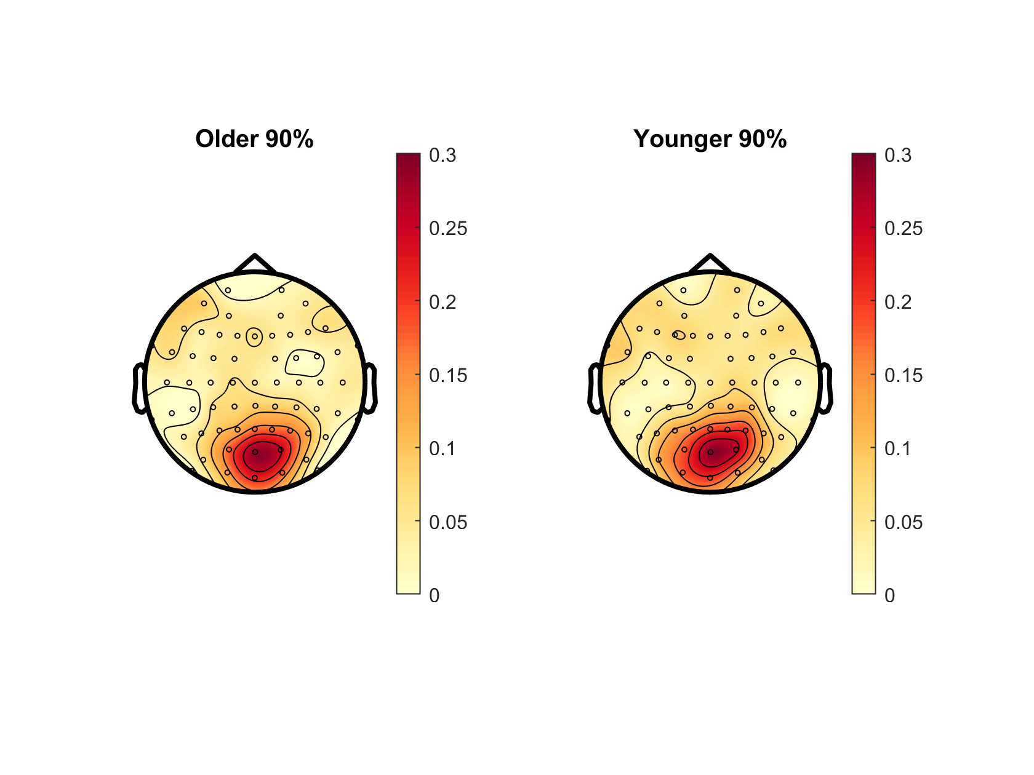
Notes:
? Slightly different to Oz PSD in plotPowerSpec script

Slide 3
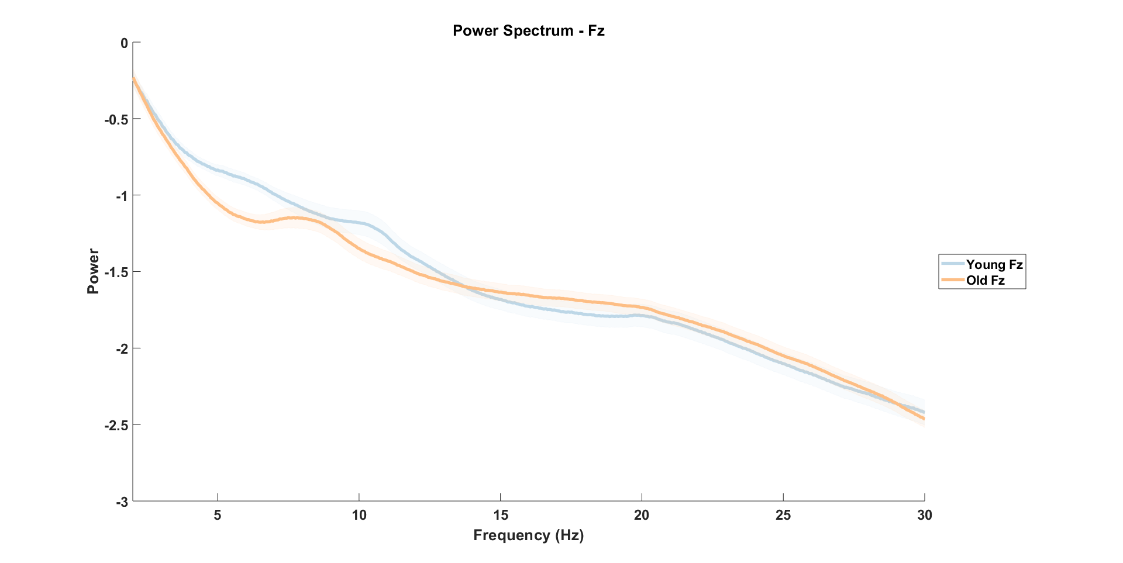

Slide 4
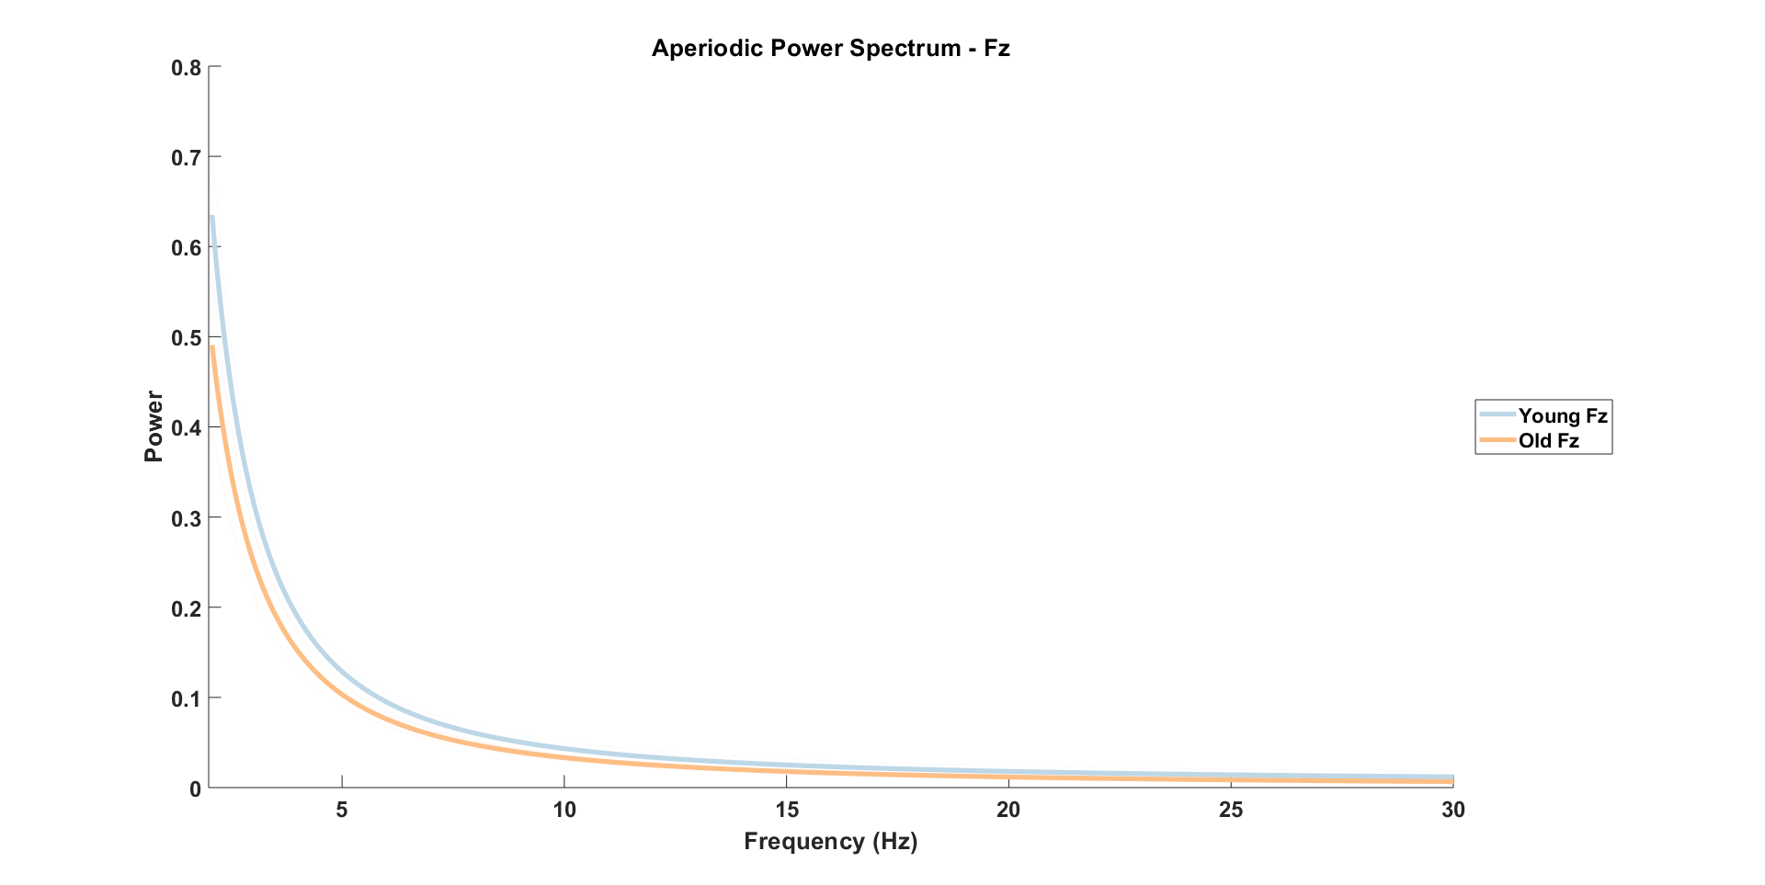

Slide 5
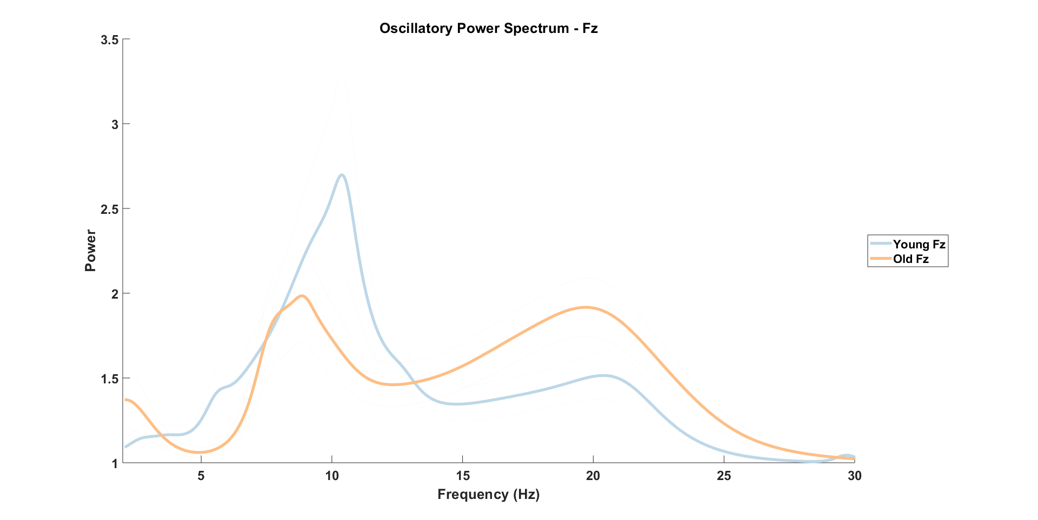

Slide 6
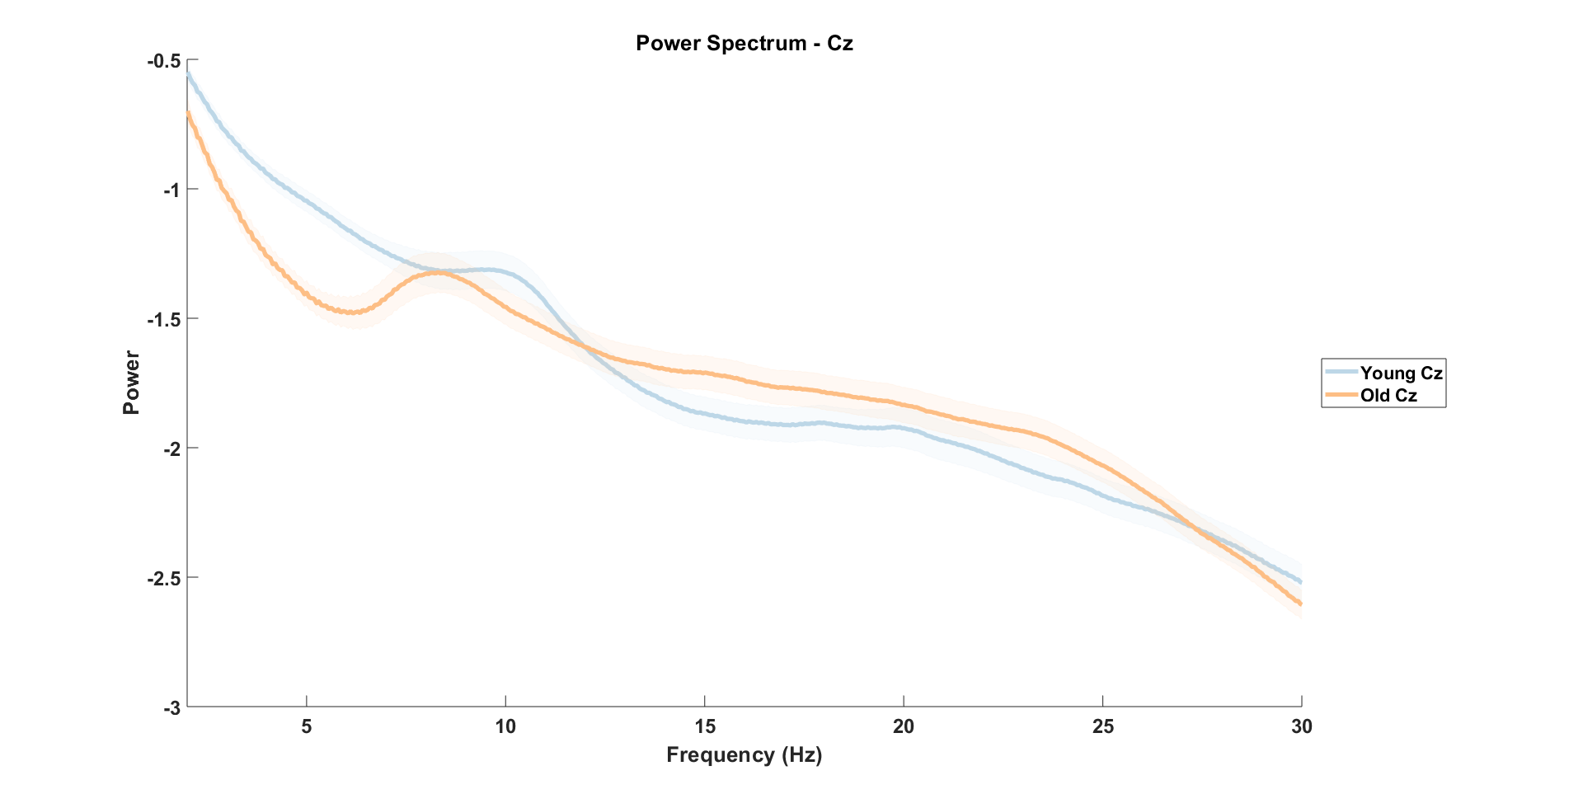

Slide 7
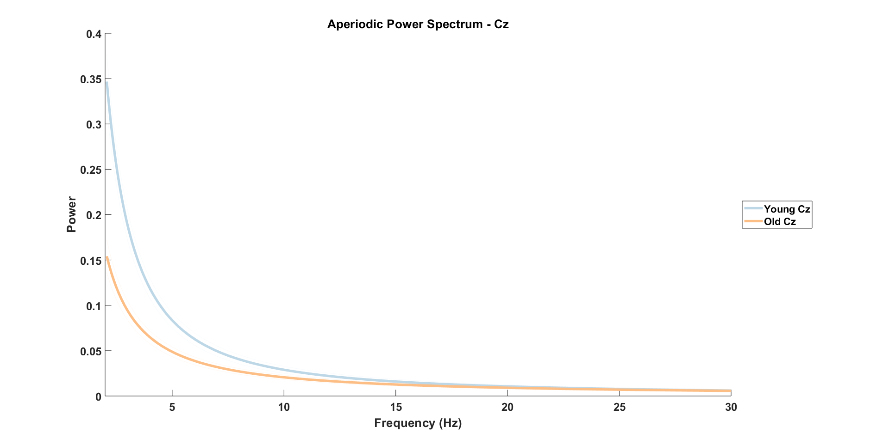

Slide 8
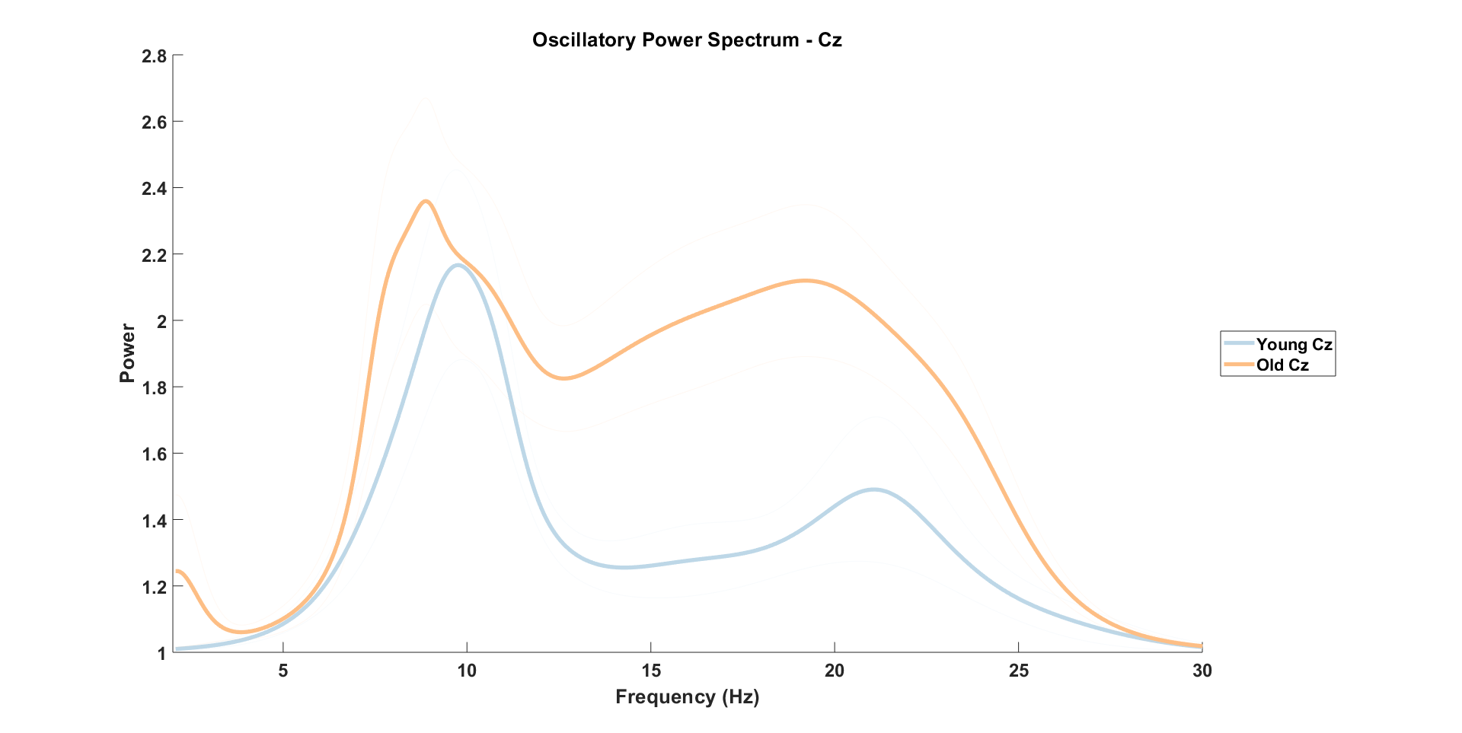

Slide 9
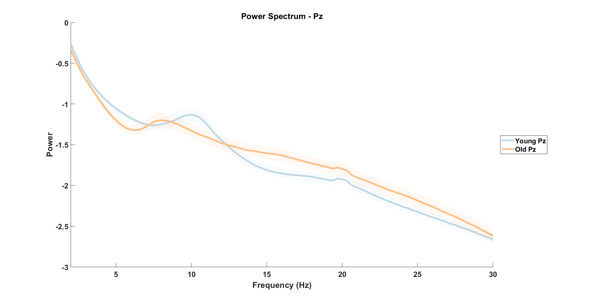

Slide 10
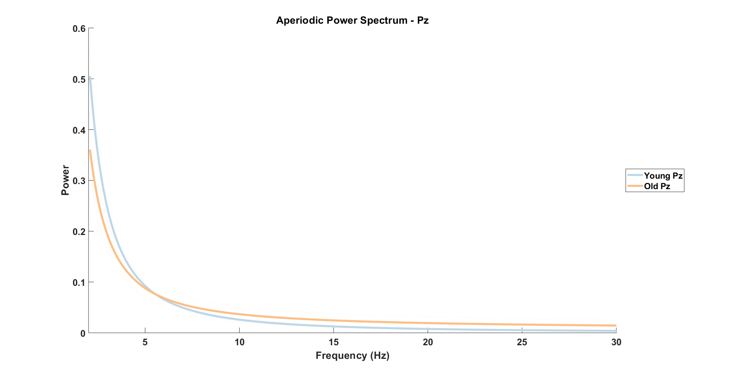

Slide 11
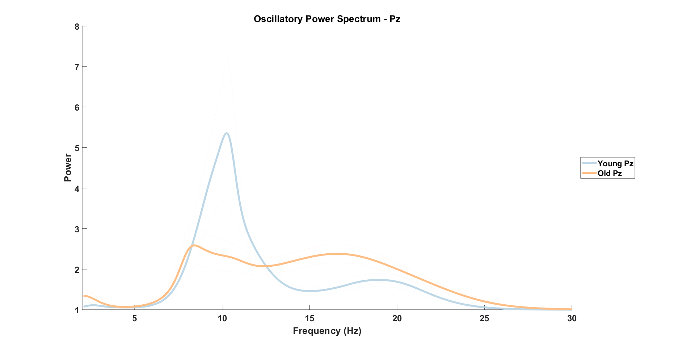

Slide 12
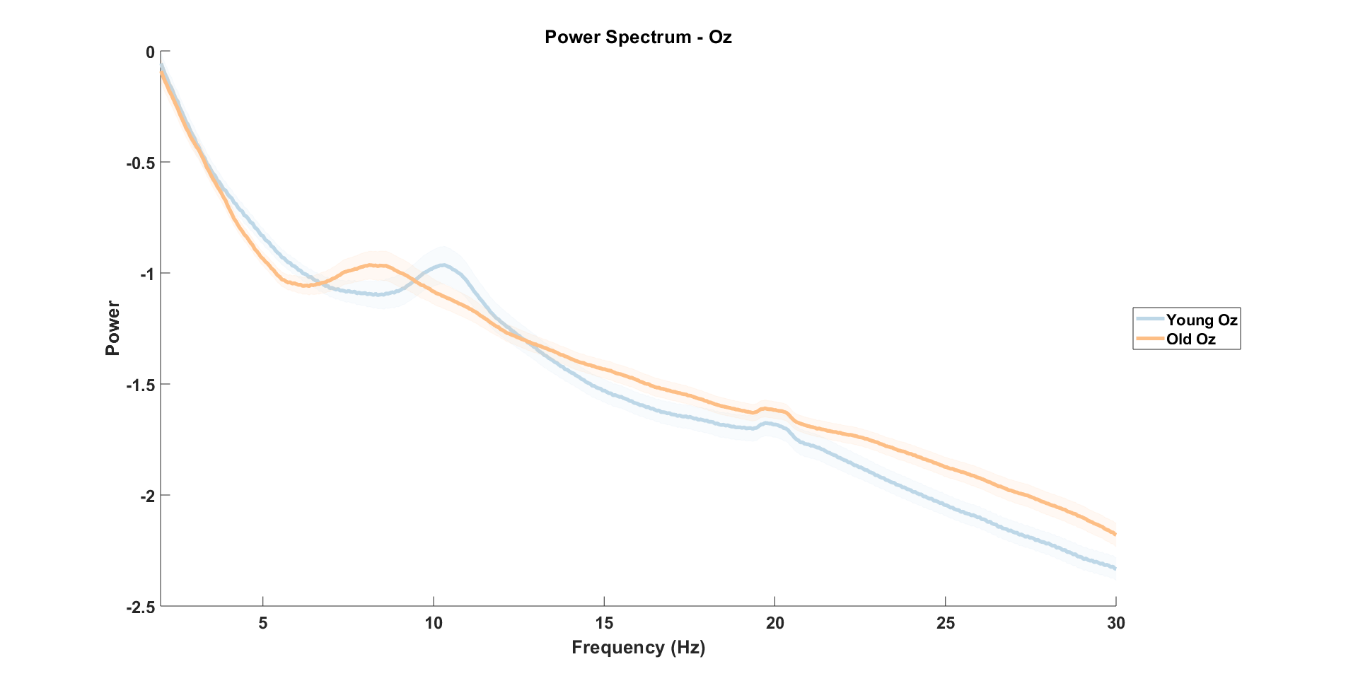

Slide 13
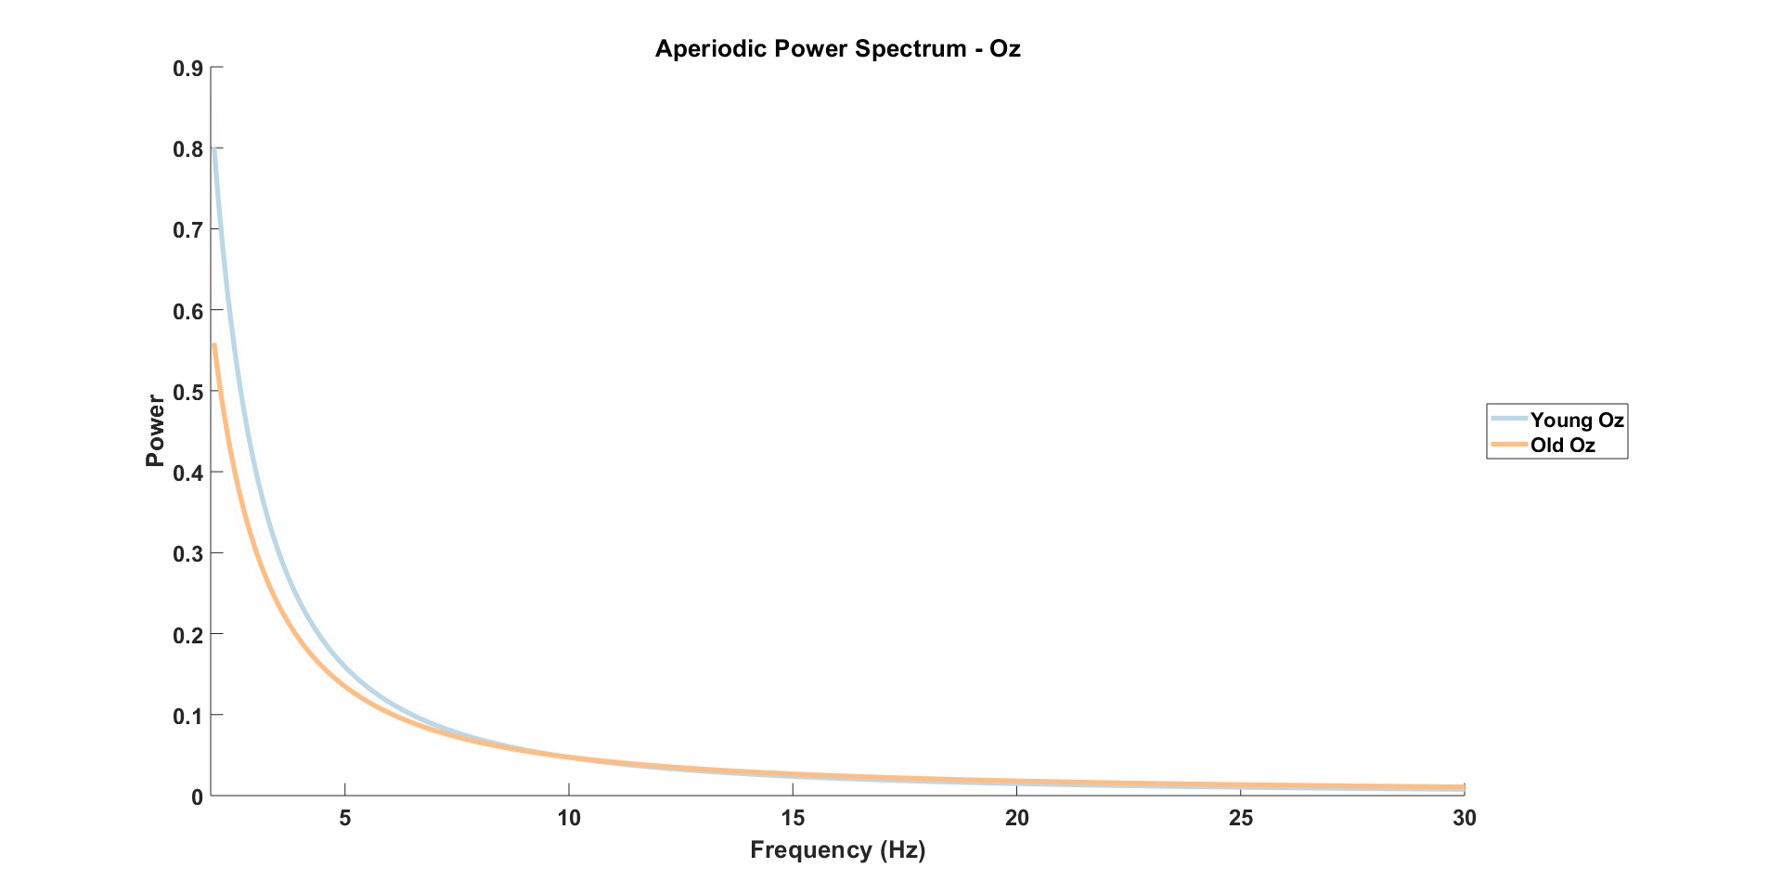

Slide 14
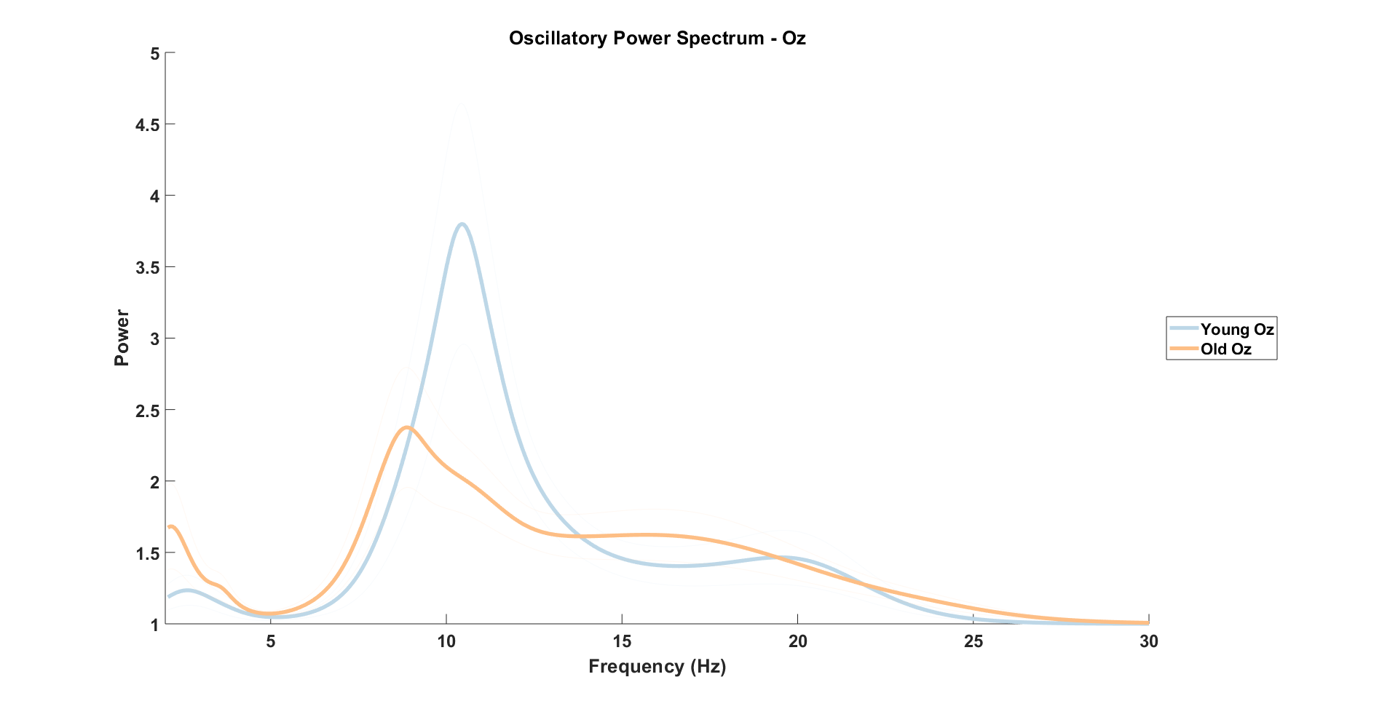

Slide 15
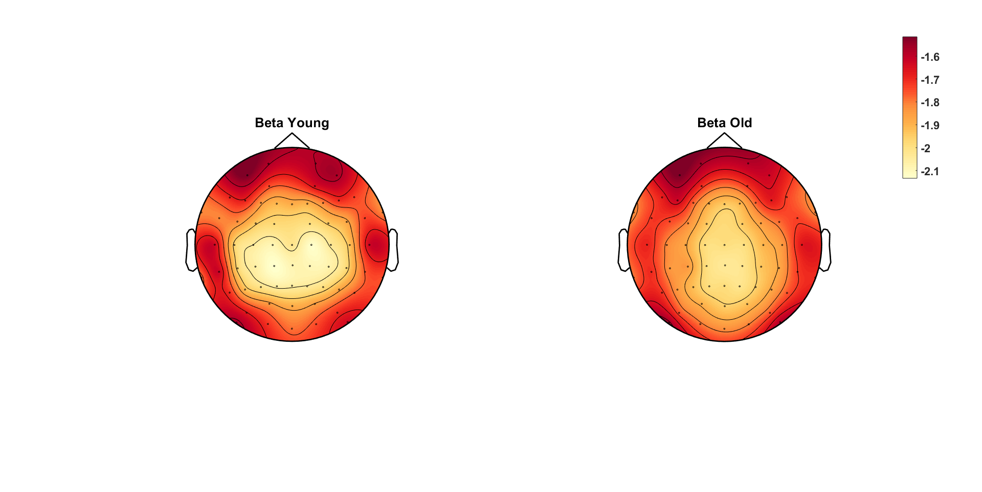
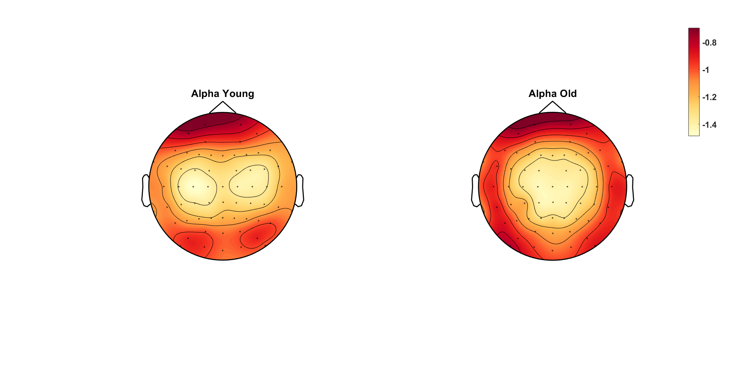
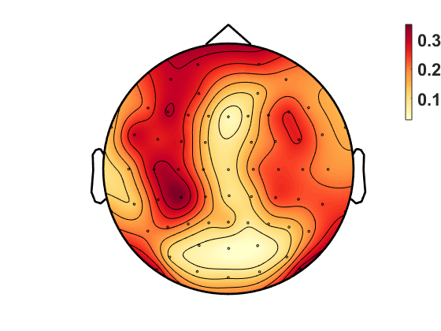
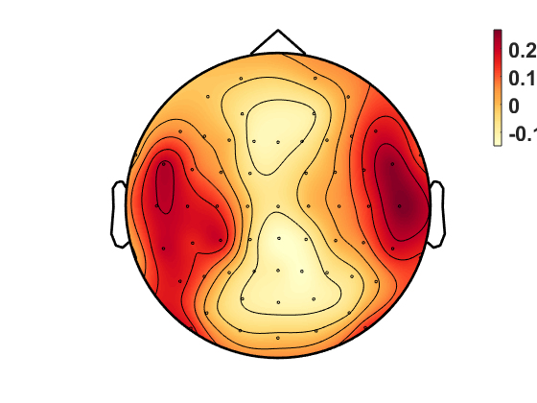
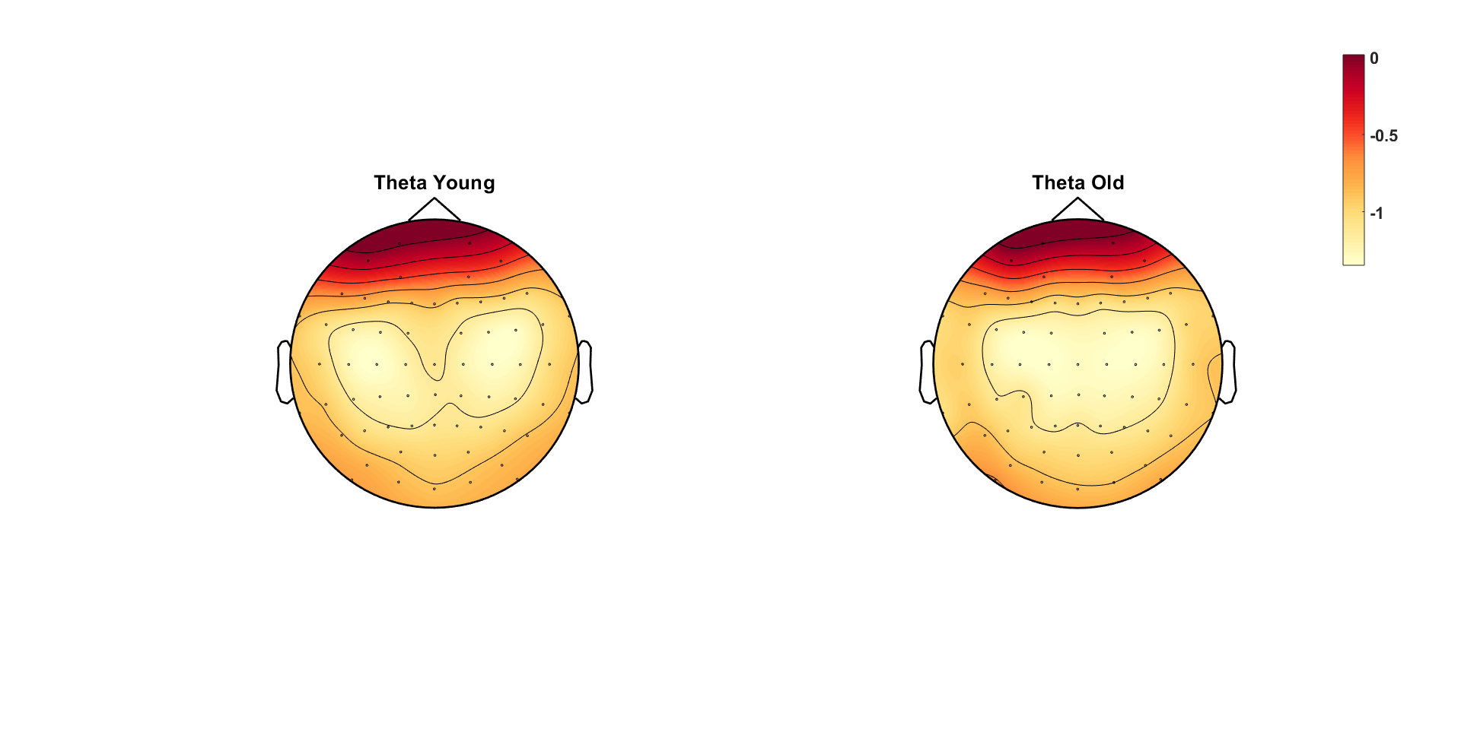
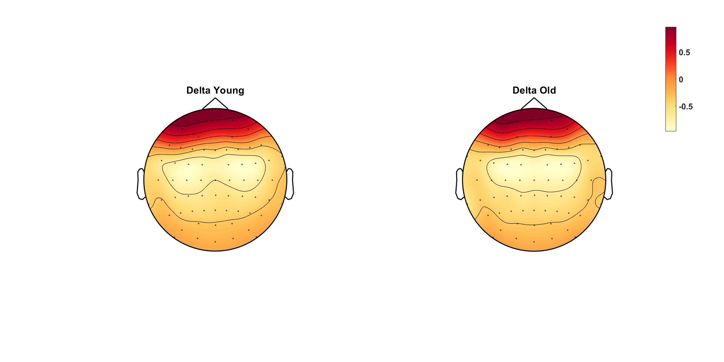
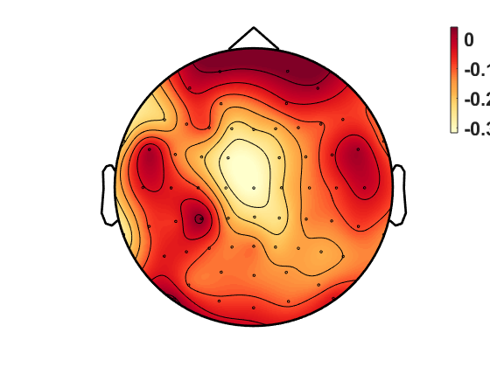
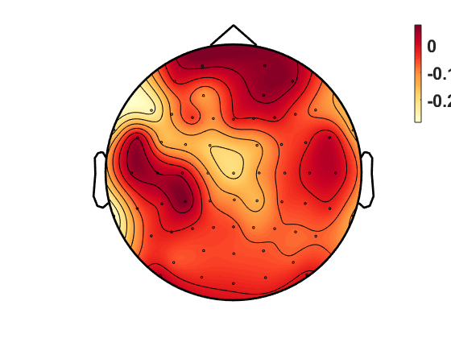
Power
Beta Old-Young
Alpha Old-Young
Theta Old-Young
Delta Old-Young
Notes:
REPLICATE TOPOGRAPHIES with all_osci (new scripts) – DONE (next slide)
+ differences old-young for each freq band - DONE

Slide 16
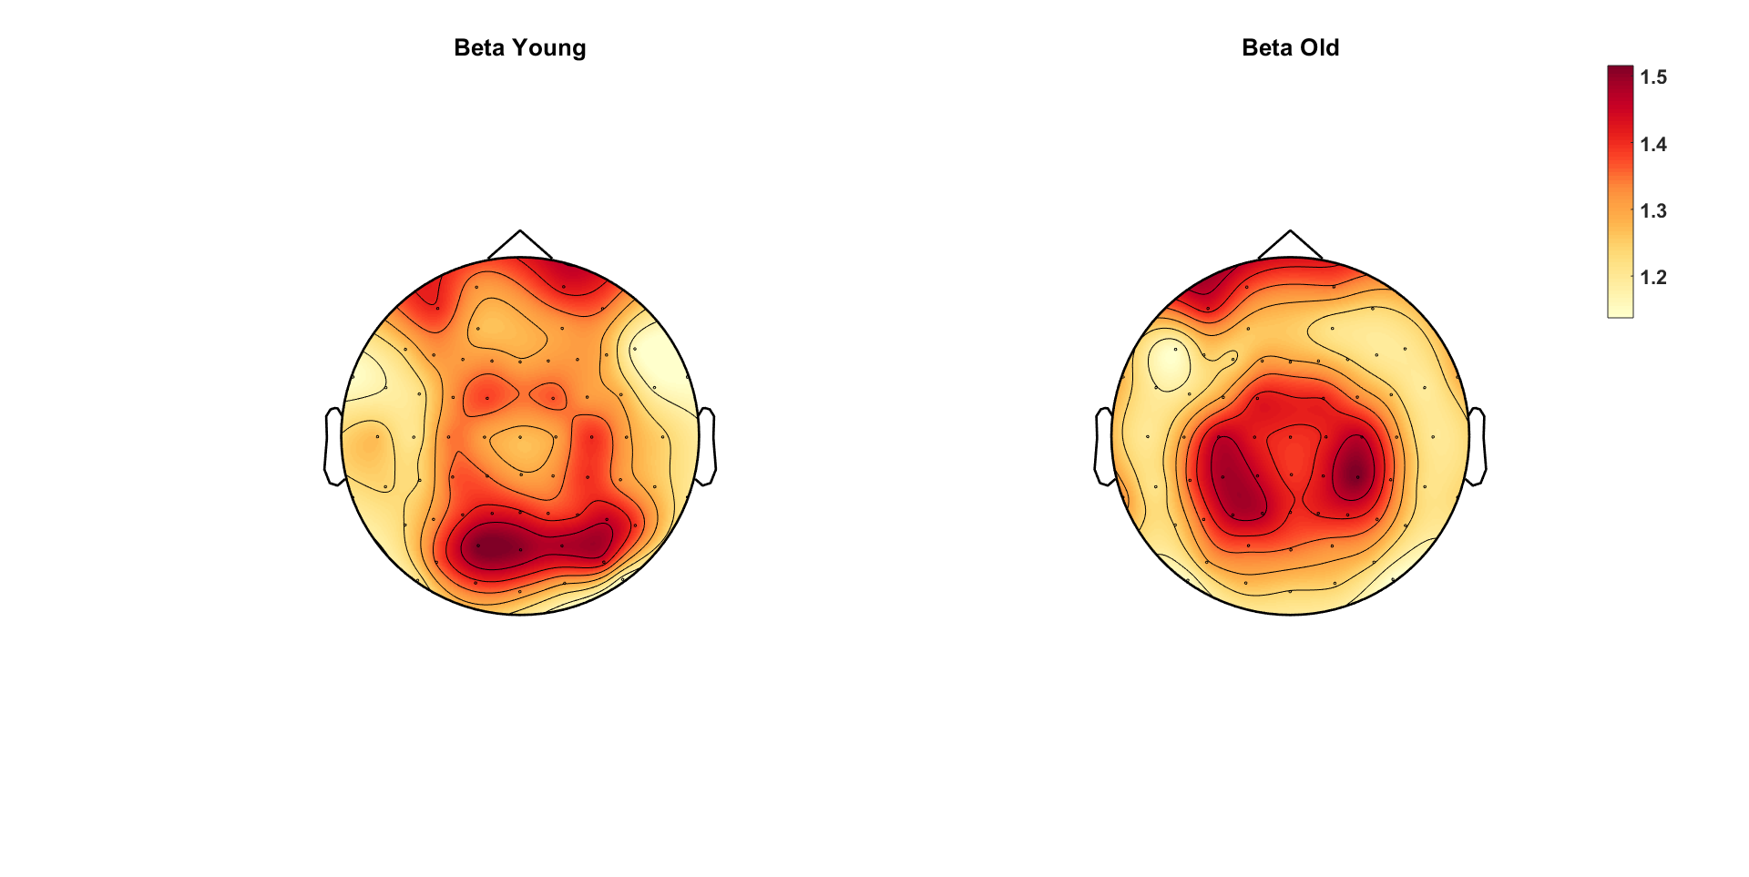
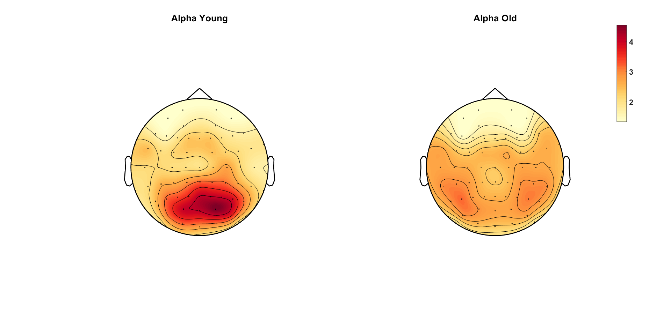
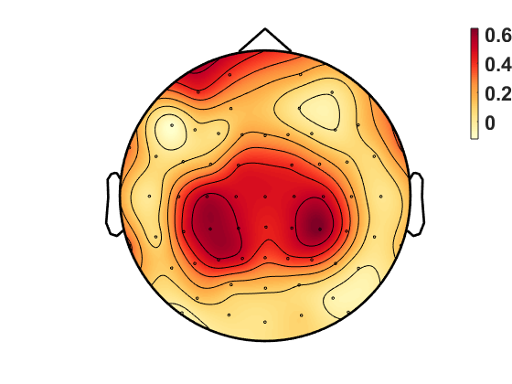
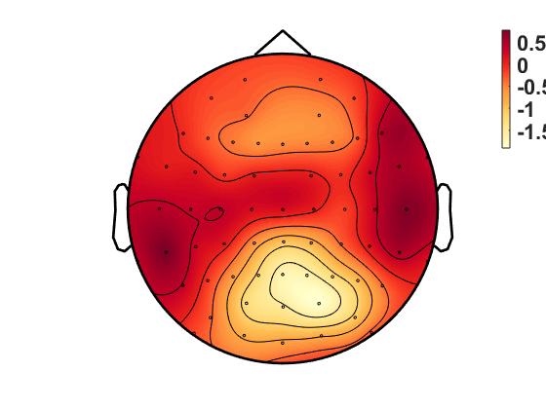
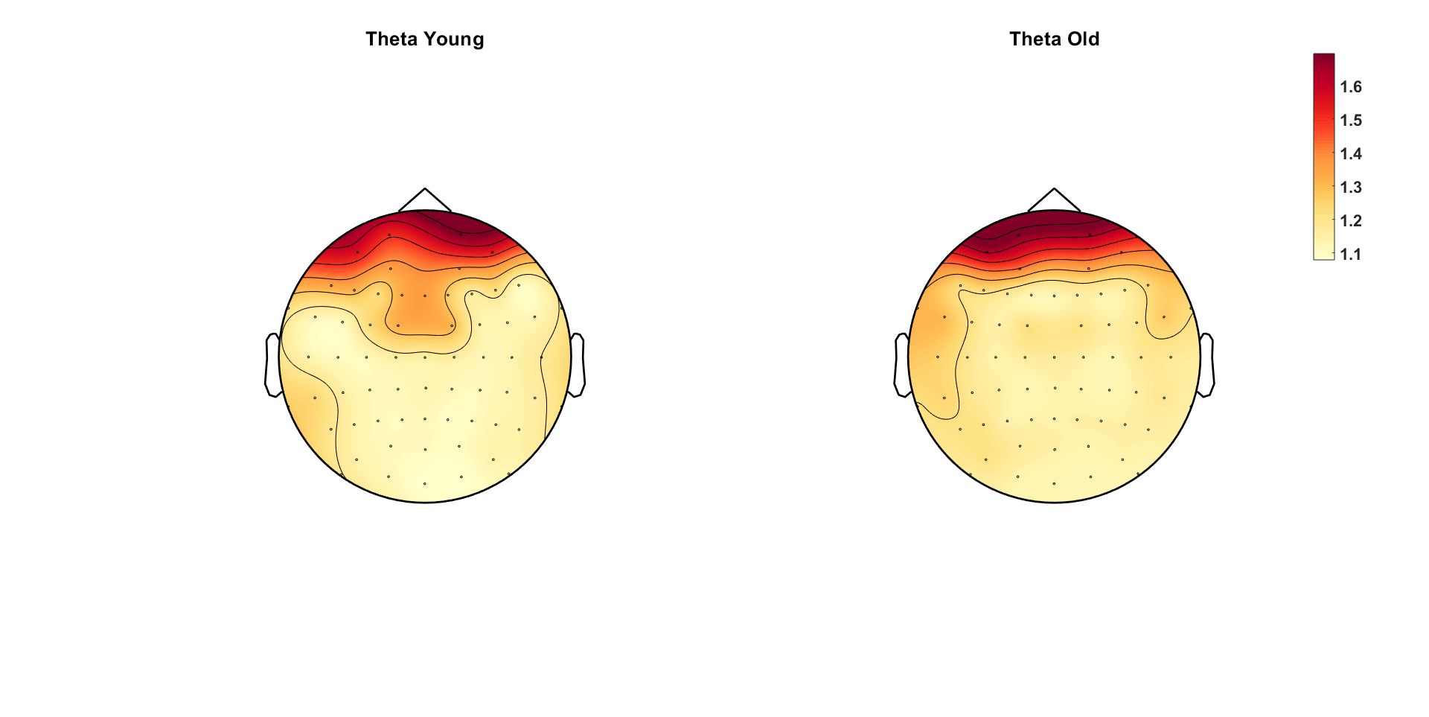
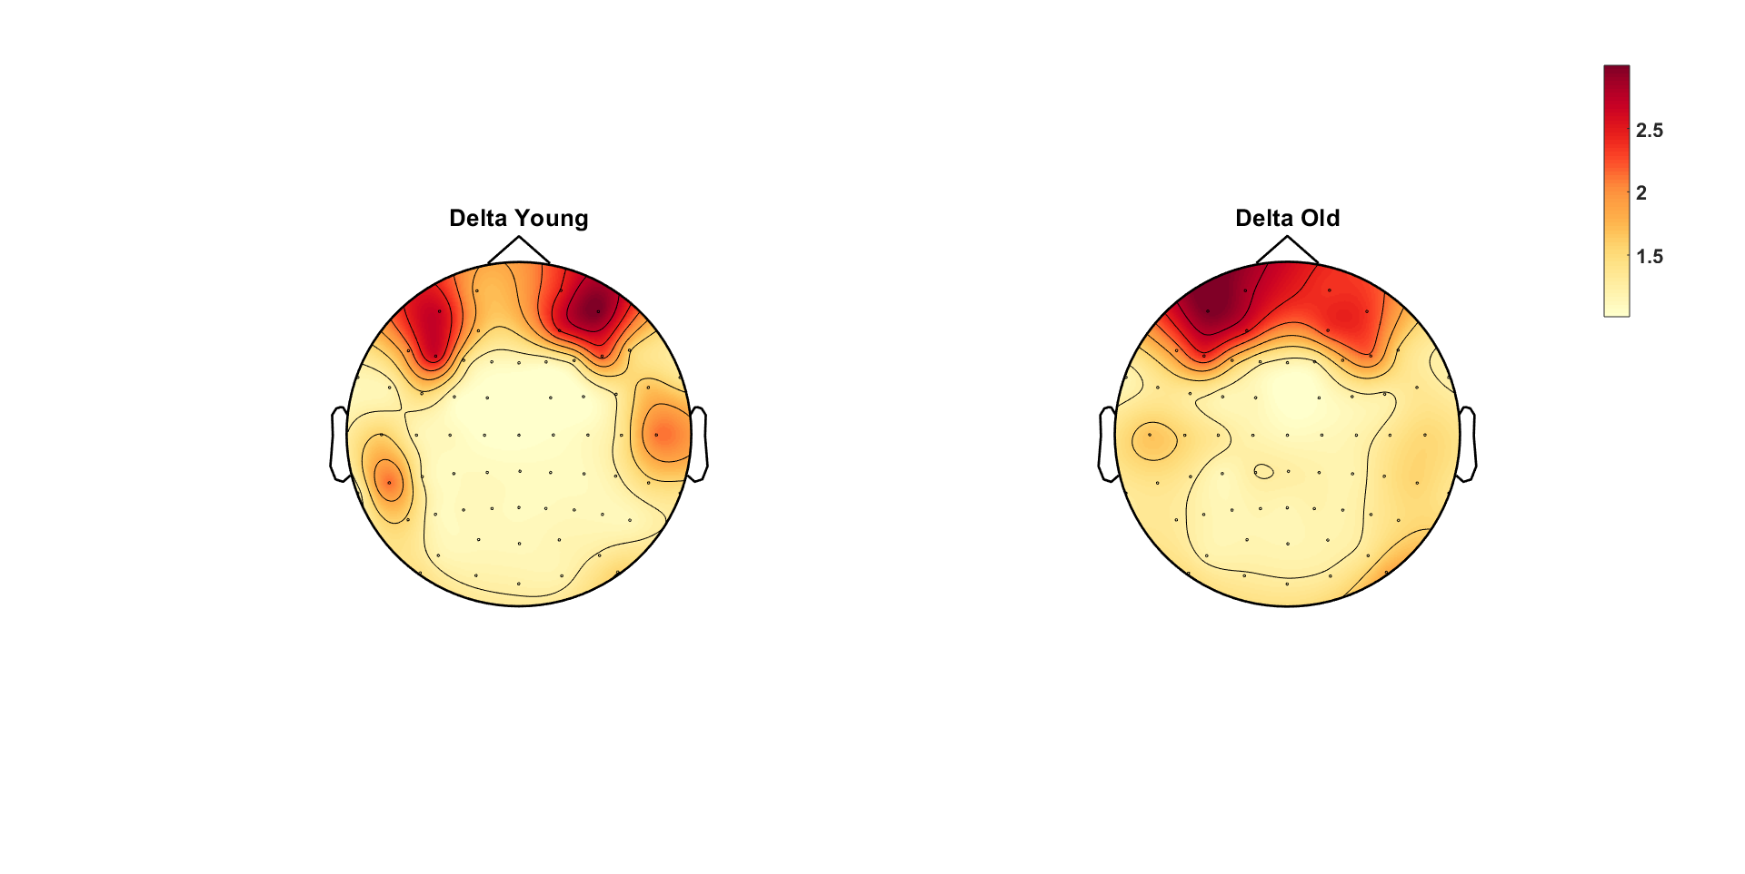
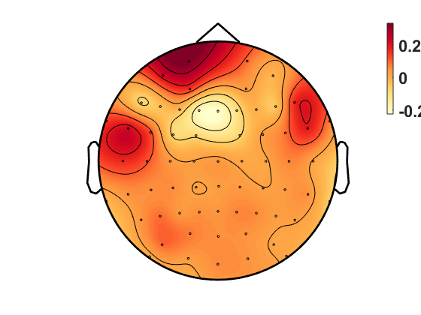
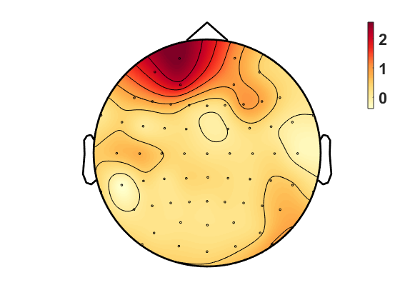
Oscillatory Component
Beta Old-Young
Alpha Old-Young
Theta Old-Young
Delta Old-Young

Slide 17
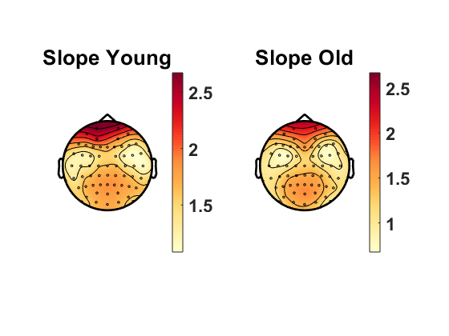
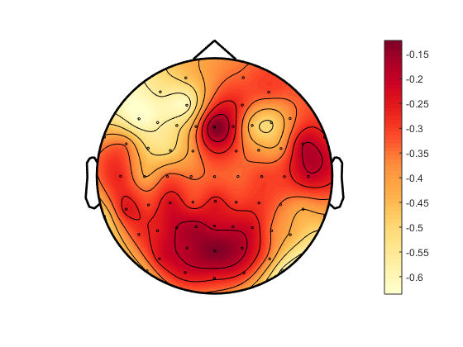
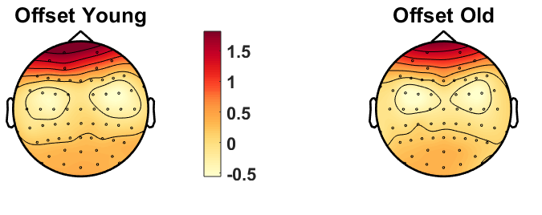
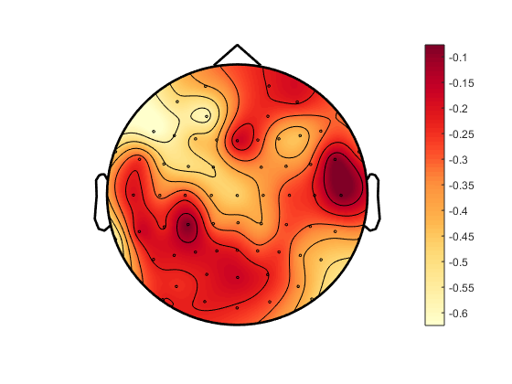
Aperiodic Slope – Younger 90% vs Older 90%
Old-Young
Aperiodic Offset – Younger 90% vs Older 90%
Old-Young
Notes:
Add old-young difference topograpjy - DONE

Slide 18
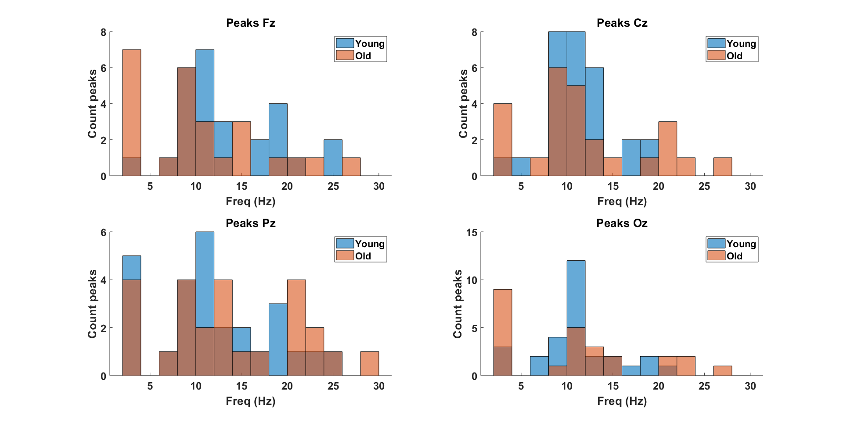
OLD SETTINGS

Slide 19
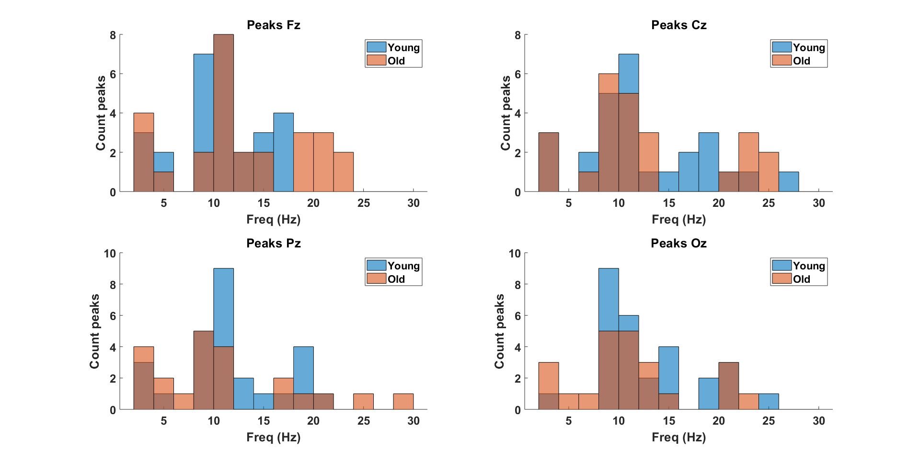
NEW SETTINGS

Slide 20
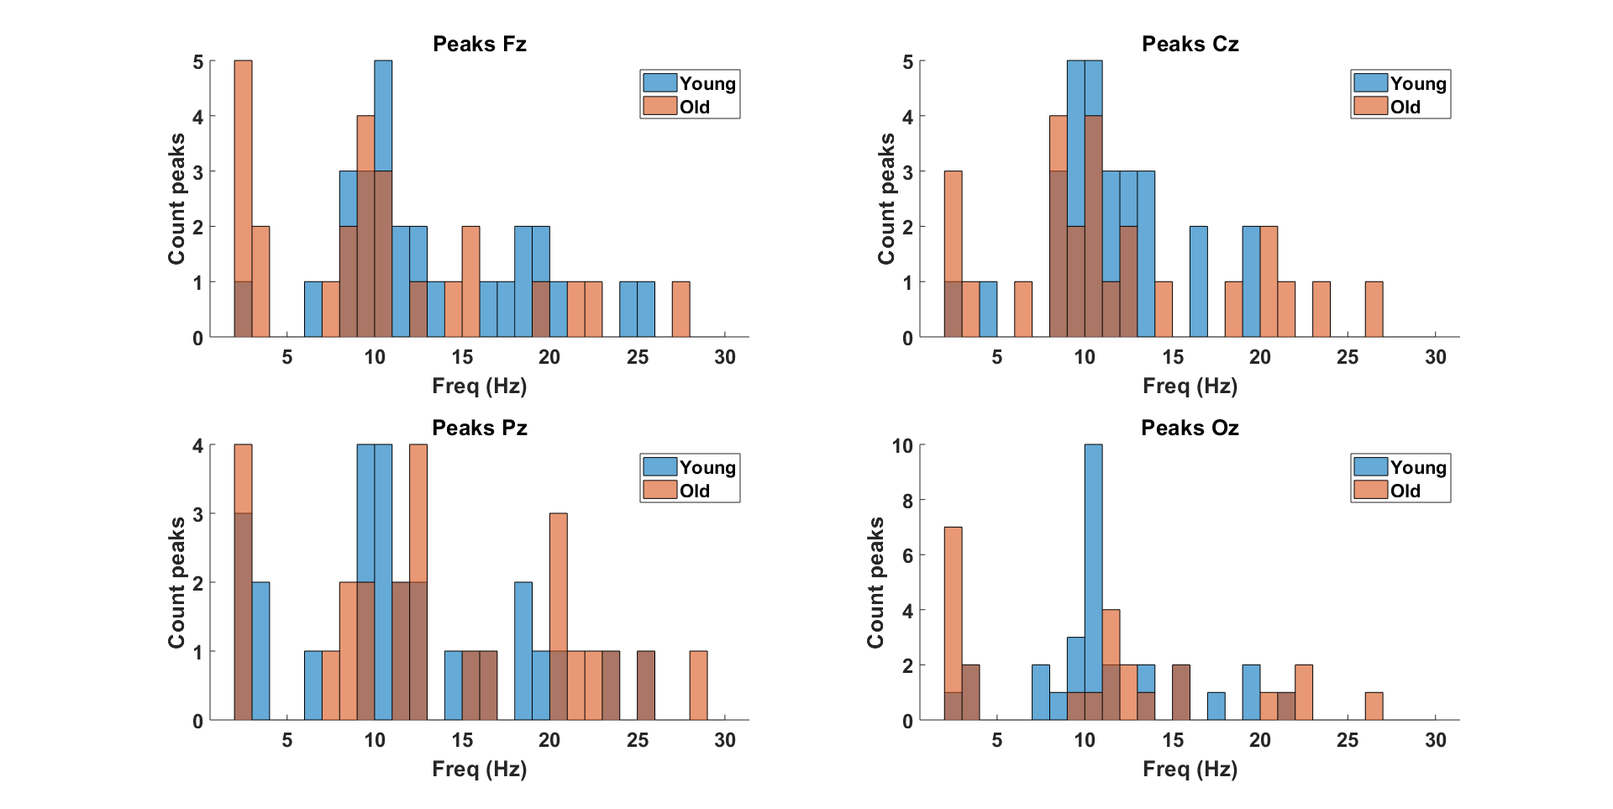
OLD SETTINGS
Notes:
Proportion of individuals with a peak in the alpha range and the theta/delta range (see all_detectedpeaks variable) – DONE (see slide 18)

Slide 21
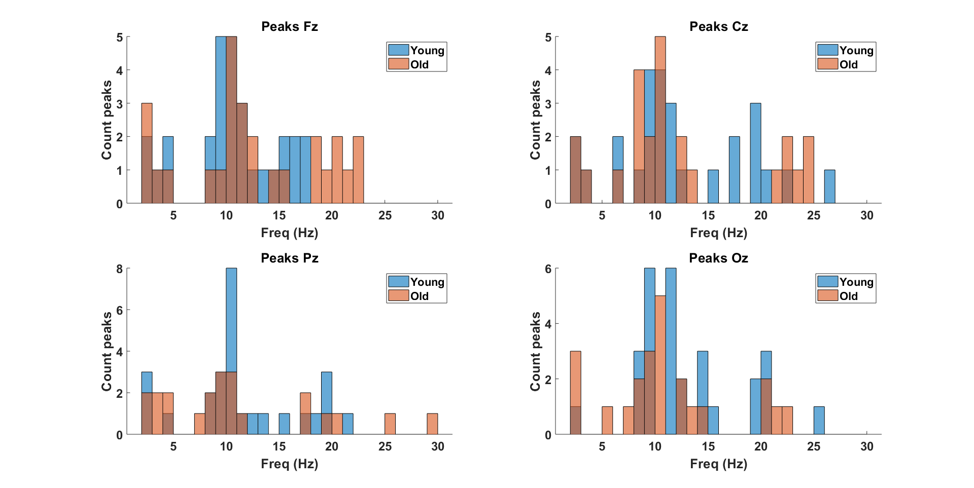
NEW SETTINGS

Slide 22
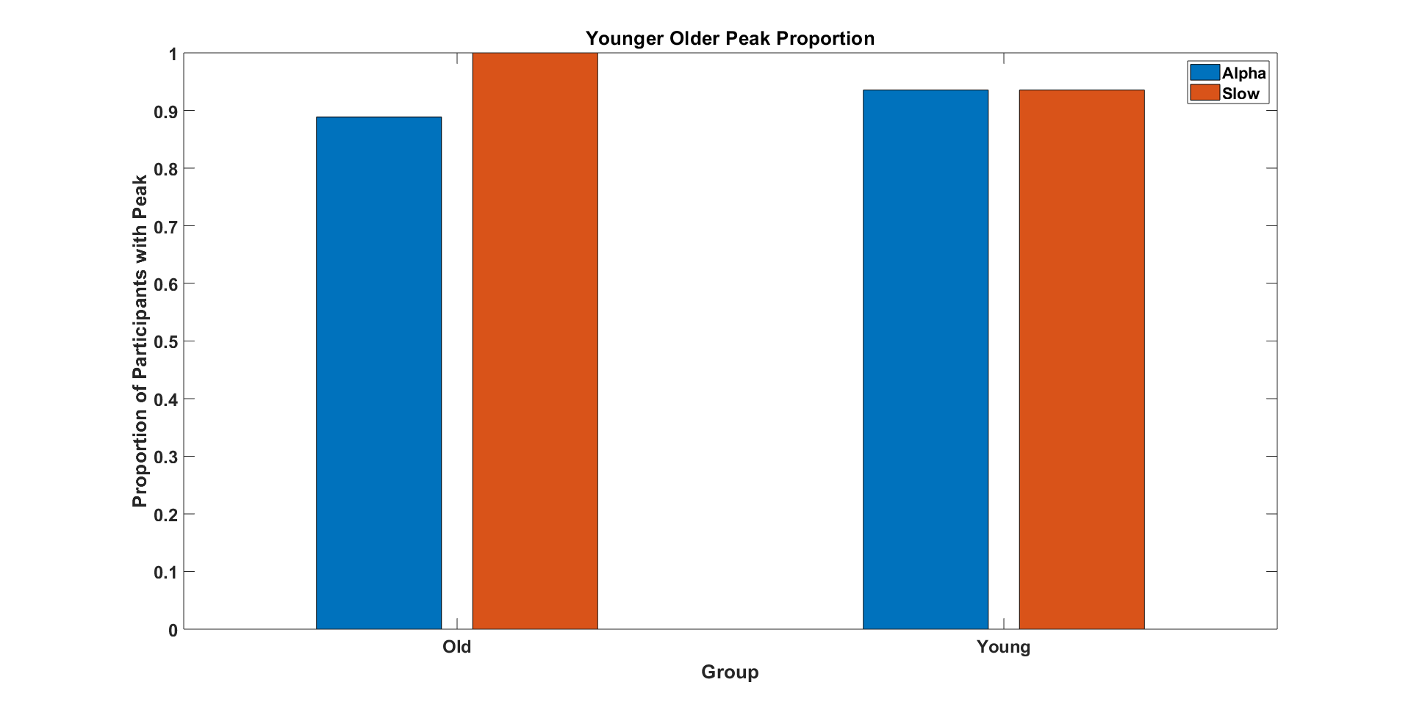

Slide 23
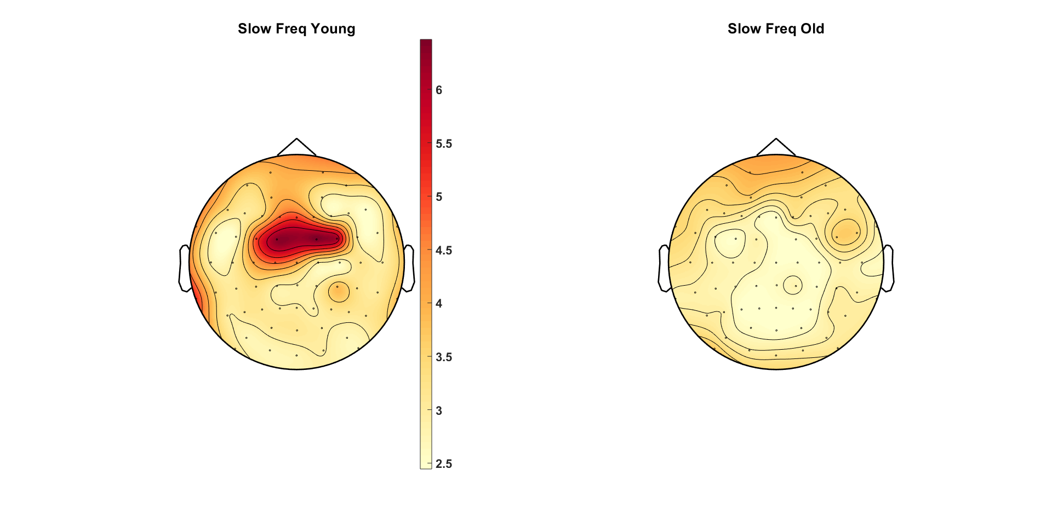
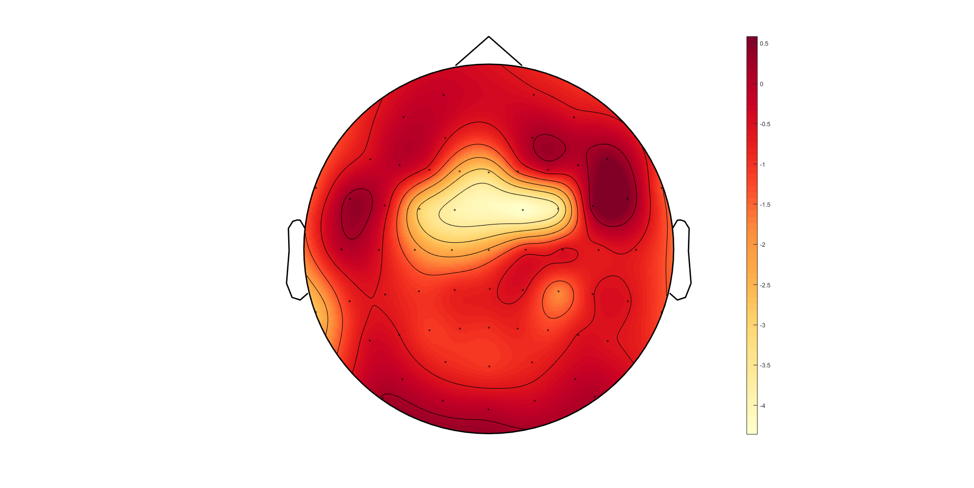
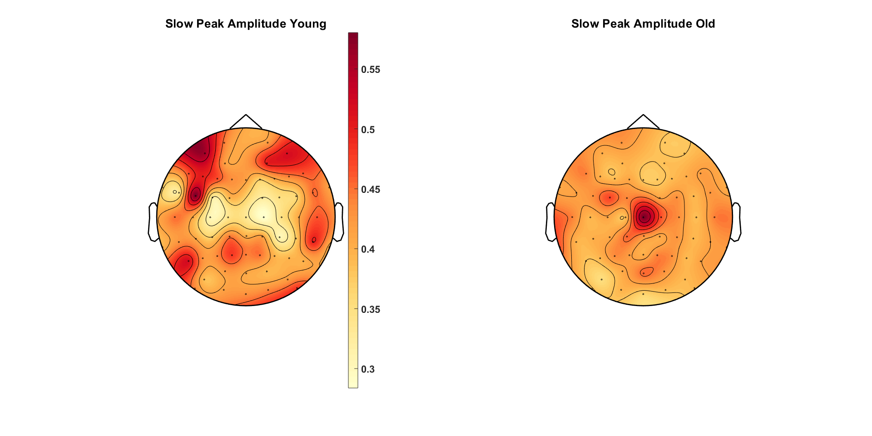
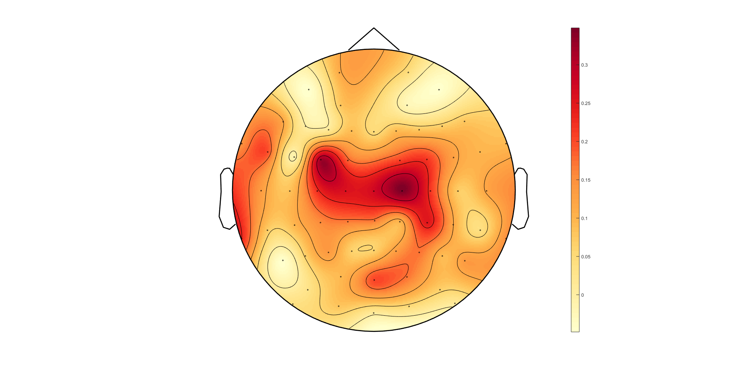
Slow Peak Frequency – Younger 90% vs Older 90%
Old-Young
Slow Peak Amplitude – Younger 90% vs Older 90%
Old-Young
Notes:
Same scale if possible – DONE
Pull delta & theta together - DONE

Slide 24
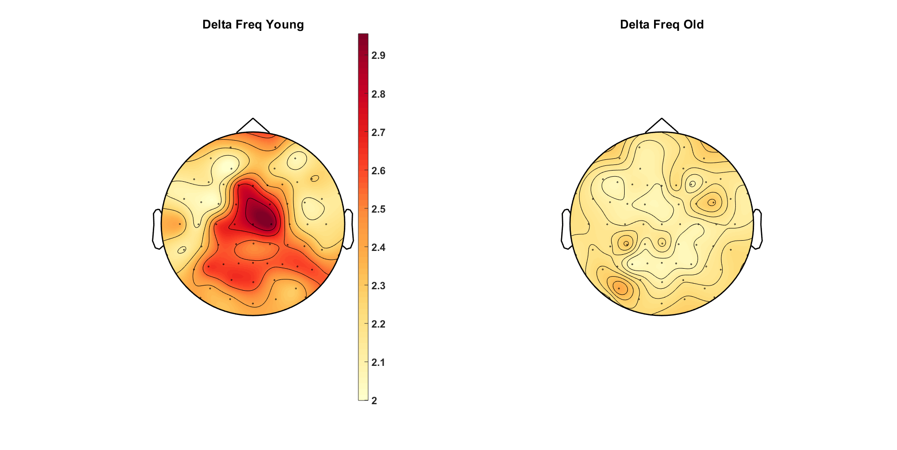
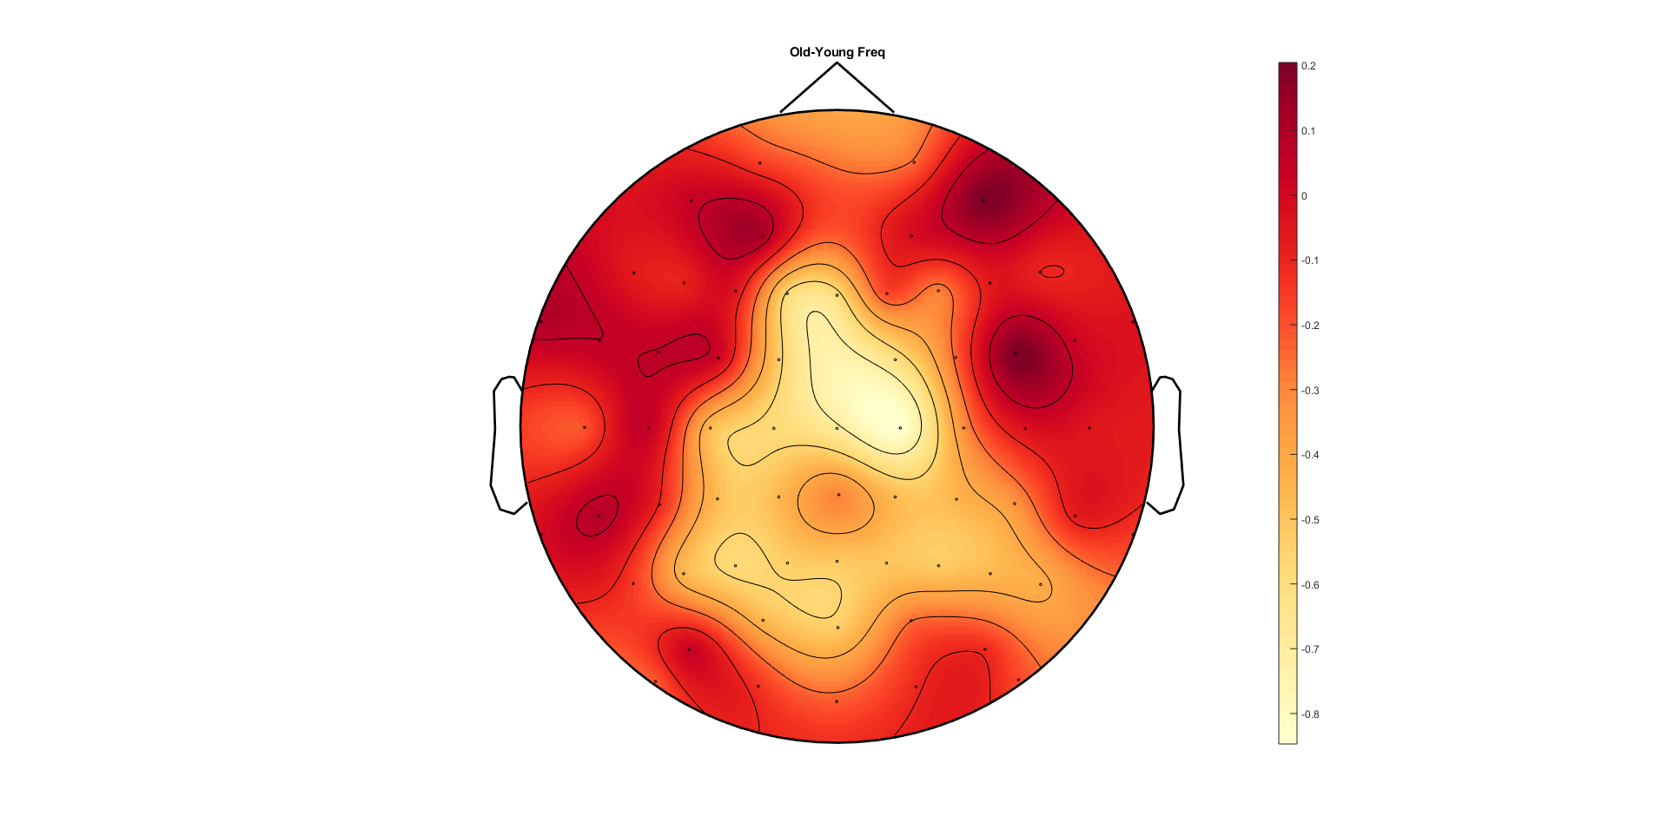
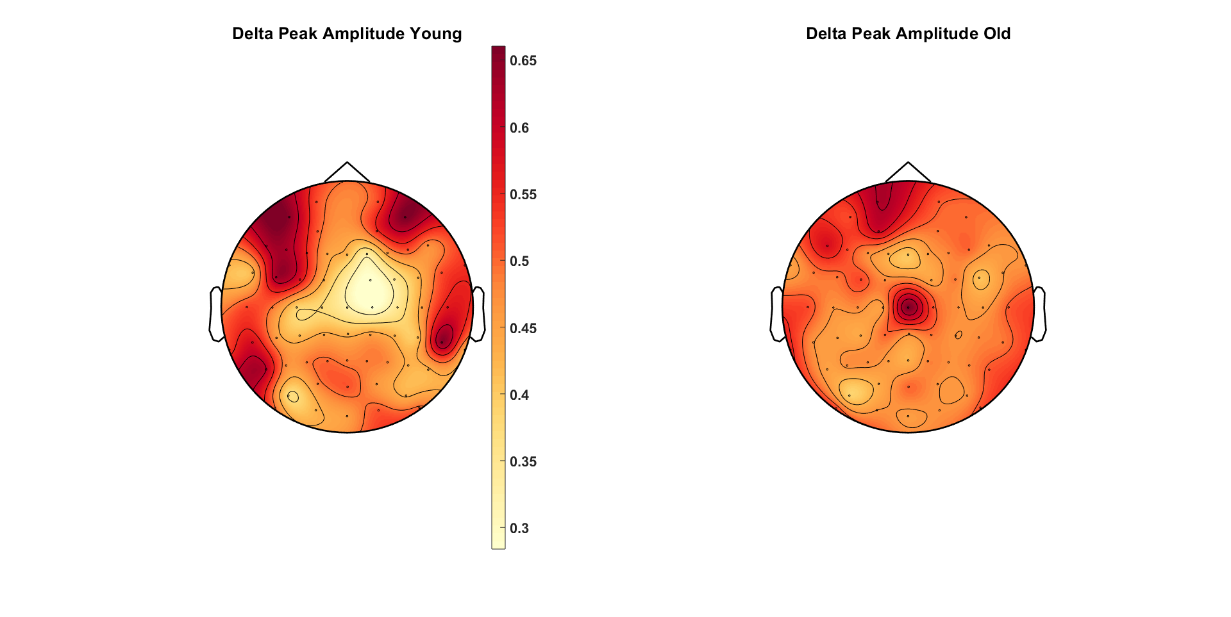
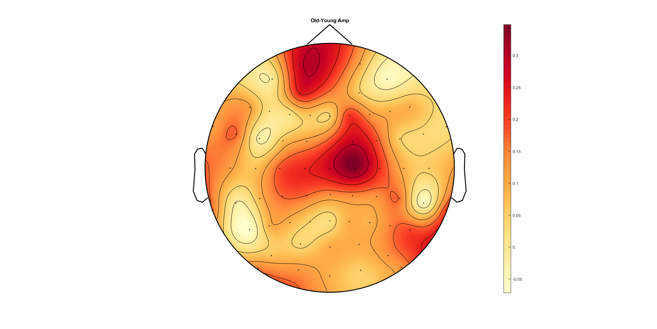
Delta Peak Frequency – Younger 90% vs Older 90%
Old-Young
Delta Peak Amplitude – Younger 90% vs Older 90%
Old-Young
Notes:
Same scale if possible

Slide 25
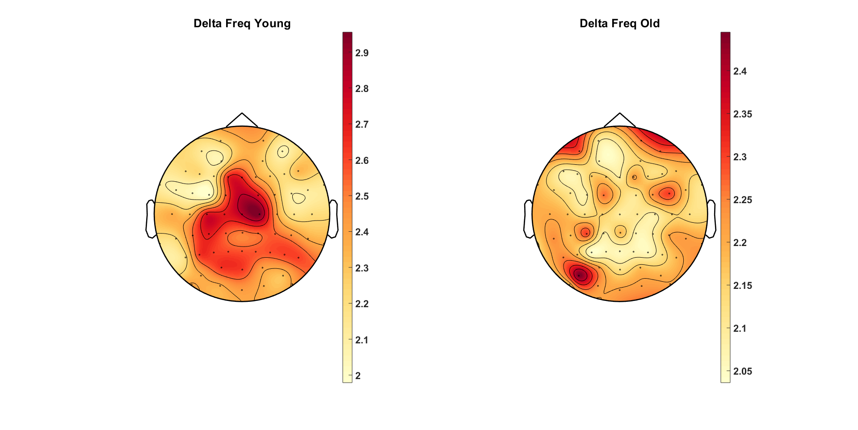
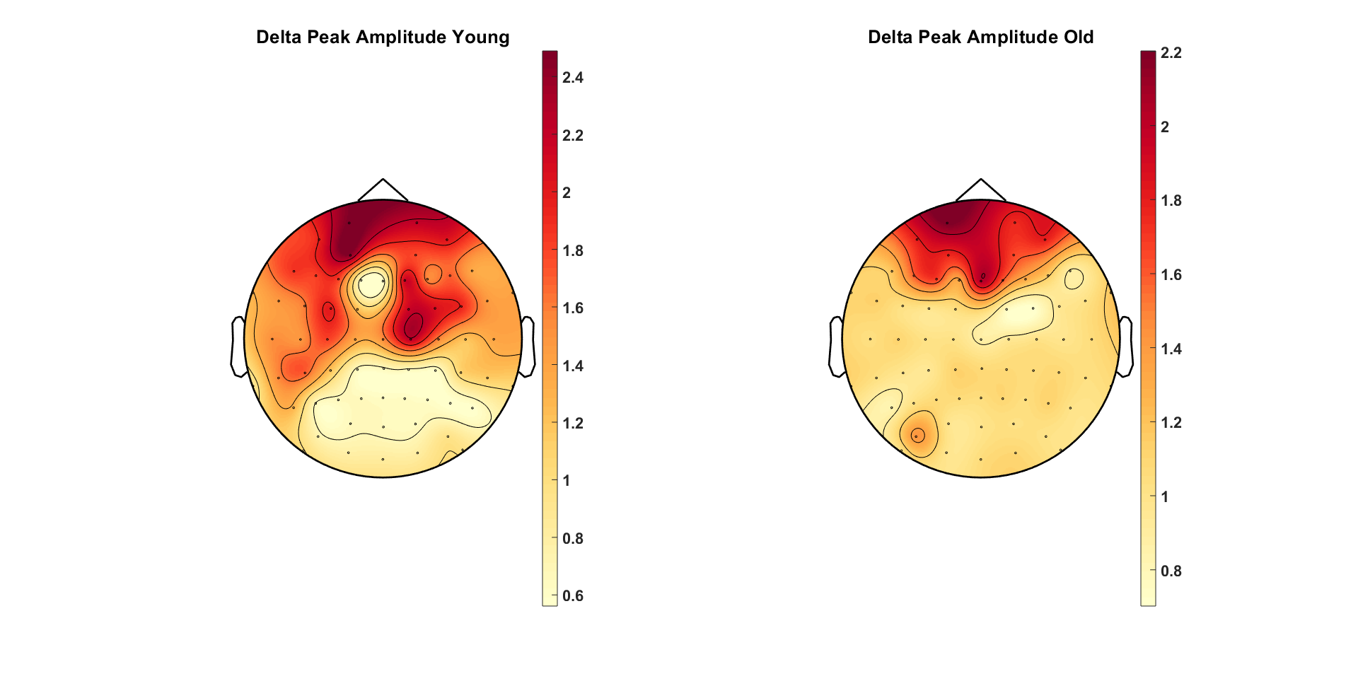
Delta Peak Frequency – Younger 90% vs Older 90%
OLD CUTOFFS
Delta Peak Amplitude – Younger 90% vs Older 90%

Slide 26
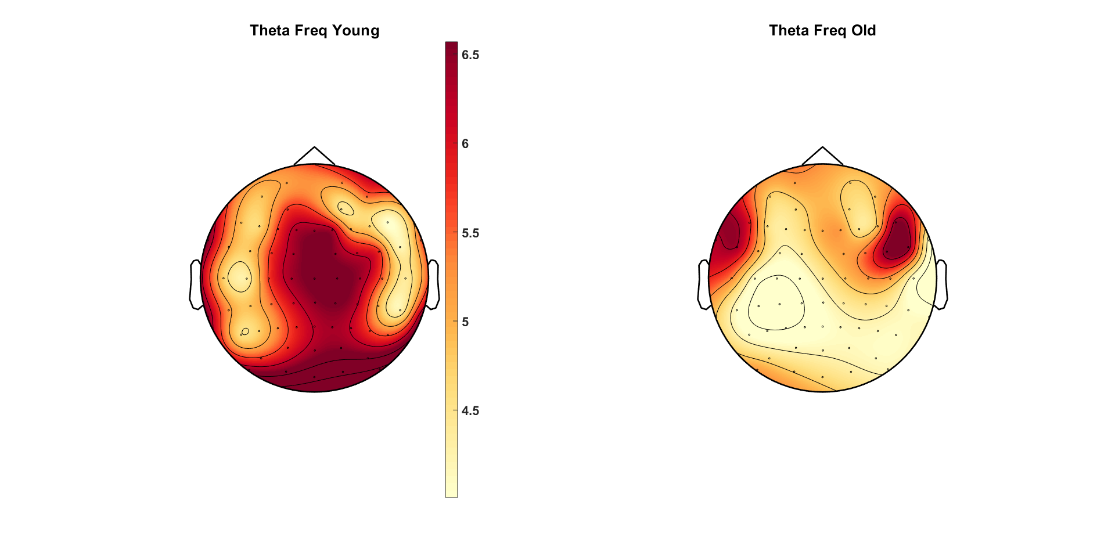



Theta Peak Frequency – Younger 90% vs Older 90%
Old-Young
Theta Peak Amplitude – Younger 90% vs Older 90%
Old-Young

Slide 27


Theta Peak Frequency – Younger 90% vs Older 90%
OLD CUTOFFS
Theta Peak Amplitude – Younger 90% vs Older 90%

Slide 28




Alpha Peak Frequency – Younger 90% vs Older 90%
Old-Young
Alpha Peak Amplitude – Younger 90% vs Older 90%
Old-Young

Slide 29


Alpha Peak Frequency – Younger 90% vs Older 90%
OLD CUTOFFS
Alpha Peak Amplitude – Younger 90% vs Older 90%

Slide 30




Beta Peak Frequency – Younger 90% vs Older 90%
Old-Young
Beta Peak Amplitude – Younger 90% vs Older 90%
Old-Young

Slide 31


Beta Peak Frequency – Younger 90% vs Older 90%
OLD CUTOFFS
Beta Peak Amplitude – Younger 90% vs Older 90%

Slide 32

Young 90% Coherence

Slide 33

Old 90% Coherence

Slide 34

Difference TF – Young-Old

Slide 35

Young 90% Coherence

Slide 36

Old 90% Coherence

Slide 37

Difference TF – Young-Old

Slide 38

Young 90% Coherence

Slide 39

Old 90% Coherence

Slide 40

Difference TF – Young-Old

Slide 41





Slide 42





Slide 43





Slide 44





Slide 45





Slide 46





Slide 47





Slide 48





Slide 49




Slide 50





Slide 51





Slide 52





Slide 53





Slide 54





Slide 55





Slide 56





Slide 57





Slide 58





Slide 59





Slide 60





